Slide 1
Fun logical puzzles
By Michael Zarkov

Slide 2
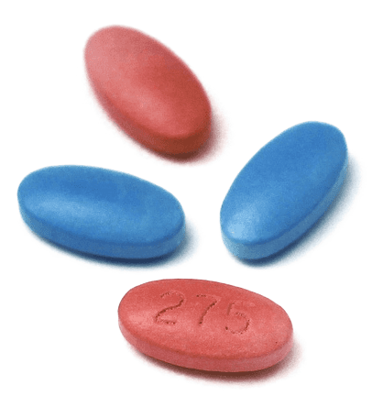
Blind man and pills Problem:
The blind man has 2 blue pills and 2 red pills in his pocket. How does he take exactly 1 red and 1 blue pill today and 1 red and one blue pill tomorrow?

Slide 3
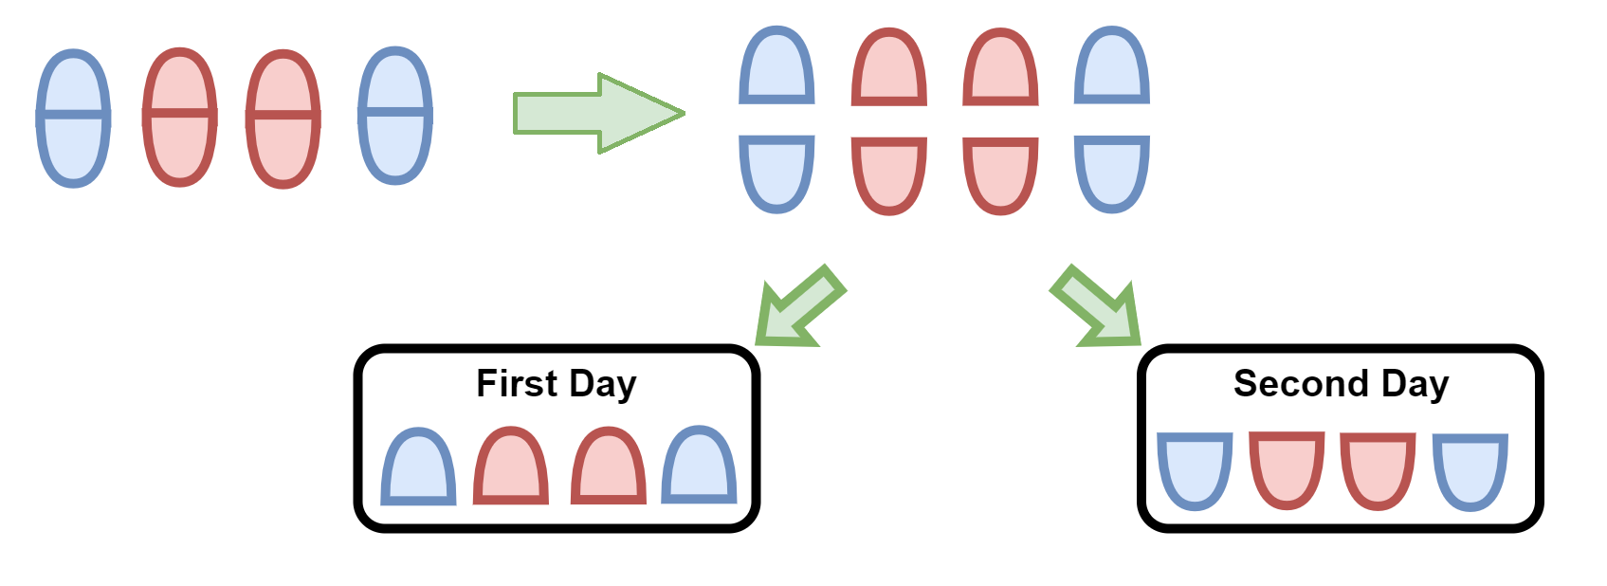
Blind man and pills Solution:
He breaks each pill in halve and takes one halve of the pills today and one halve tomorrow.

Slide 4

Barber paradox Problem:
Does the barber who shaves only those who don't shave themselves shave himself?

Slide 5

Barber paradox Solution:
, then
, then

Slide 6
Barber paradox Solution:
Let’s look at the definition of the barber:
Conclusion: the barber does not exist.

Slide 7

Fork in the road Problem:
Each path has a guard who knows which path is which. One guard always lies and one always tells the truth. Can you determine the correct path with only one question?

Slide 8
Fork in the road Solution:
The question we need is:
“If I ask the other guard “Is your path, the path to the toilet?” what would his answer be?”

Slide 9
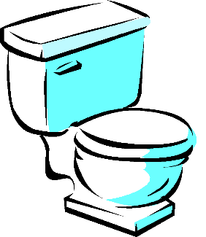
Fork in the road Solution:
Possible answers:
Liar guard
Ask this guard
Honest guard
No toilet
The answer we get is: True/Yes

Slide 10
Fork in the road Solution:
Possible answers:
Honest guard
Ask this guard
Liar guard
No toilet
The answer we get is: True/Yes

Slide 11
Fork in the road Solution:
Possible answers:
Liar guard
No toilet
Ask this guard
Honest guard
The answer we get is: False/No

Slide 12
Fork in the road Solution:
Possible answers:
Honest guard
No toilet
Ask this guard
Liar guard
The answer we get is: False/No

Slide 13
Fork in the road Solution:
In conclusion, if the guard you asked says True/Yes, then the toilet is on the path of this guard. If they say False/No, then it is the other path.

Slide 14
Navigating an infinitely dense minefield Problem:
Consider a unit square [0, 1]×[0, 1]. I place a landmine at every point with rational coordinates (so at (a, b) for a, b ∈ Q. Can you find a continuous path in the square from (0, 0) to (1, 1) that does not pass through any mines?

Slide 15
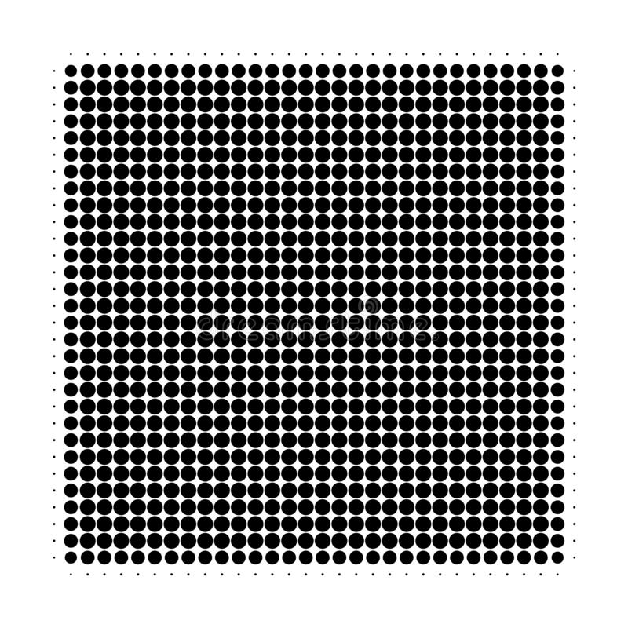
Navigating an infinitely dense minefield Solution:
(0, 1)
(1, 1)
A lot of mines.
(0, 0)
(1, 0)

Slide 16
Navigating an infinitely dense minefield Solution:
There are as many natural numbers as there are rational.
|N| = |Q|
There are as many natural numbers as there are pairs of rational numbers.
|N| = |{(x, y) | x, y ∈ Q}|
There are countably infinitely many pairs of rational numbers.

Slide 17
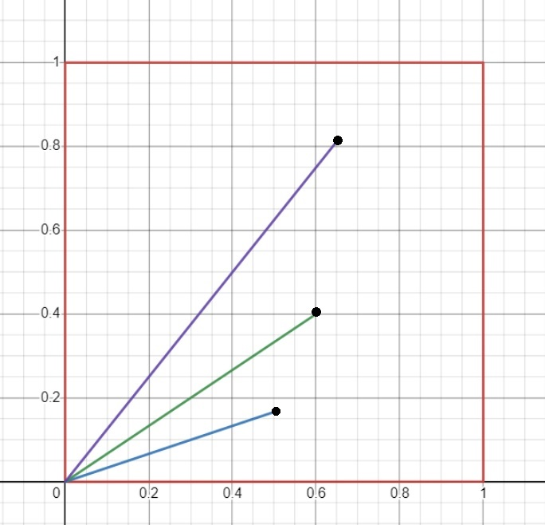
Navigating an infinitely dense minefield Solution:
(0.65, 0.8)
(0.5, 0.16)
(0.6, 0.4)

Slide 18

Navigating an infinitely dense minefield Solution:
But the set of lines that go through the origin has the cardinality of the continuum. So, there are more lines than mines.
So, there exists a line through the origin which does not go through any mines.
One such line is:
$$y=\sqrt{2}x ; \sqrt{2}=\frac{y}{x}$$

Slide 19
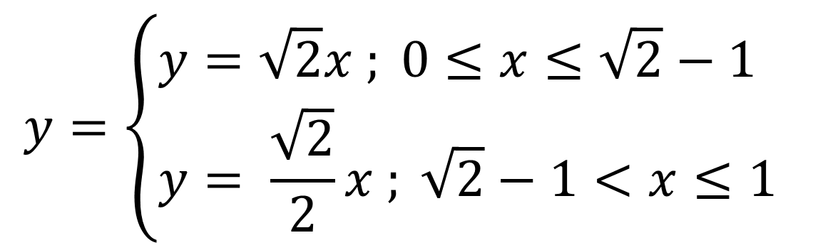
Navigating an infinitely dense minefield Solution:
A complete path that doesn’t go through any mines:
$$y=\left\{\begin{aligned}&y=\sqrt{2}x ; 0≤x≤\sqrt{2}−1 \\ &y= \frac{\sqrt{2}}{2}x ; \sqrt{2}−1<x≤1\end{aligned}\right.$$

Slide 20
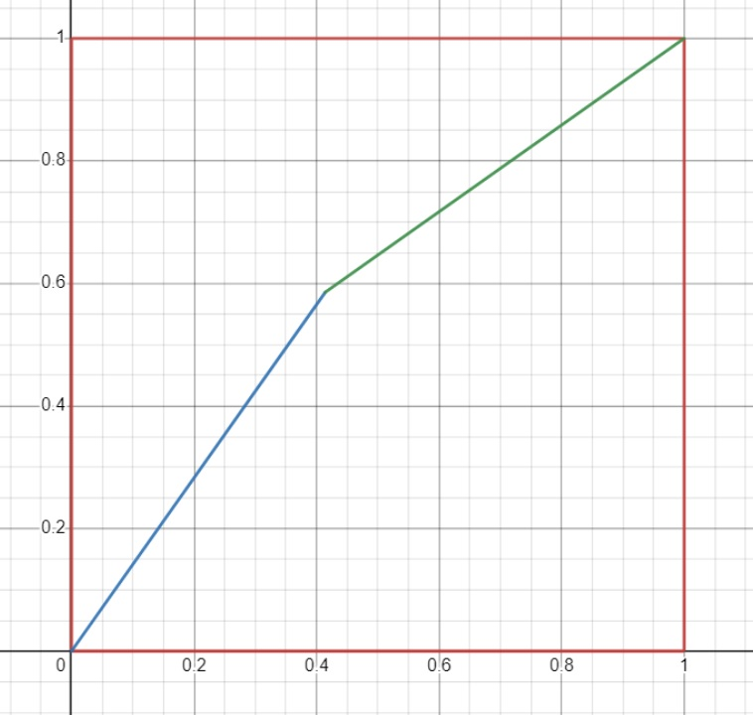
Navigating an infinitely dense minefield Solution:

Slide 21
Thank you for your attention The end

